Slide 1

Global AI Adoption Impact Analysis
Sara Shockley
Supra Coder DDI Apr2026 Cohort
CAO: 10JUN26

Slide 2
Contents
Study Overview
AI Adoption Landscape
AI Maturity & Business Outcomes
Workforce Impacts
Recommendations and Way Forward

Slide 3

Study Overview: Measuring AI Adoption and Organizational Impact
Dataset: Global AI Adoption & Workforce Impact Dataset (Kaggle)
Company-level data across industries and countries
Includes adoption maturity, workforce, and business metrics
Study Goal: Analyze AI adoption trends, business outcomes & workforce impact
Compare adoption patterns across industries and regions
Analyze relationships between maturity, workforce, and outcomes
Analytical approach:
Python-based exploratory data analysis
Comparative analysis with correlation testing
Data Considerations and LimFacs:
Synthetic dataset designed for analysis and modeling
Findings identify trends, not direct causation
Dataset definitions lack full documentation (maturity scoring methodology)
Notes:
About Dataset
Global AI Adoption & Workforce Impact Dataset
Artificial Intelligence adoption is rapidly transforming how organizations operate, automate tasks, and reshape their workforce. Understanding the relationship between AI adoption, productivity, governance, and workforce changes is critical for researchers, analysts, and policy makers.
This dataset provides a structured view of how companies across industries and countries adopt AI technologies and how those decisions affect productivity, workforce dynamics, and operational outcomes.
The dataset captures company-level indicators including AI adoption stage, AI investments, automation rates, workforce changes, governance practices, and business performance metrics. It also includes macro-level country indicators that influence digital transformation and AI adoption patterns.
The dataset was constructed by aggregating patterns observed in global technology adoption reports, digital transformation studies, workforce analytics publications, and AI governance frameworks. Company characteristics, adoption behavior, workforce impact, productivity changes, and innovation indicators were modeled to reflect realistic organizational behavior across industries and regions.
Role distributions, investment levels, automation rates, and workforce adjustments follow structured statistical distributions designed to resemble real-world enterprise analytics datasets. Country-level indicators such as digital maturity, internet penetration, and AI research intensity were modeled to reflect global technology ecosystems.
The dataset is fully structured, cleaned, and formatted as tabular CSV files ready for:
Exploratory Data Analysis (EDA)
Data visualization
Machine learning experiments
Business analytics projects
AI adoption research
The dataset includes multiple related tables designed for relational analysis and scalable analytical workflows.

Slide 4
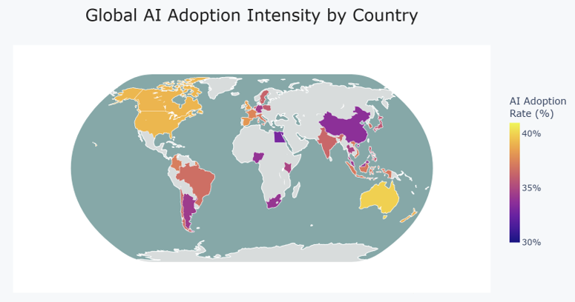
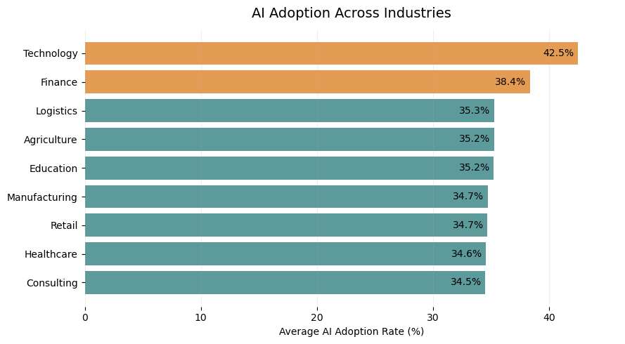
AI Adoption Landscape Variation Across Regions and Industries
Understanding where AI implementation is occurring
AI Adoption Across Industries
Global AI Adoption Intensity by Country
Early Adoption Leaders
Company-level data aggregated into country averages
Key Finding: AI adoption showed a broad global footprint with clear industry differences. Technology and Finance led average adoption rates, highlighting variation in AI implementation across sectors.
Notes:
This initial analysis establishes the AI adoption landscape before evaluating business outcomes. The dataset shows variation across both industries and countries, with Technology and Finance reporting the highest average AI adoption rates. These differences provide important context because adoption alone does not necessarily indicate success. The following analysis evaluates whether higher AI adoption and maturity are associated with measurable outcomes such as productivity improvements, revenue growth, and workforce changes.
The choropleth aggregates company-level survey responses into country-level averages. Each country's color represents the mean AI adoption rate reported by organizations located in that country, allowing comparison of AI adoption intensity independent of the number of surveyed companies.
Shading represents the average AI adoption rate of organizations in that country, not the total number of AI companies
Study includes 30 countries and 9 industries
Geographic lens → where surveyed companies show higher adoption rates
Industry lens → which sectors show higher adoption rates

Slide 5
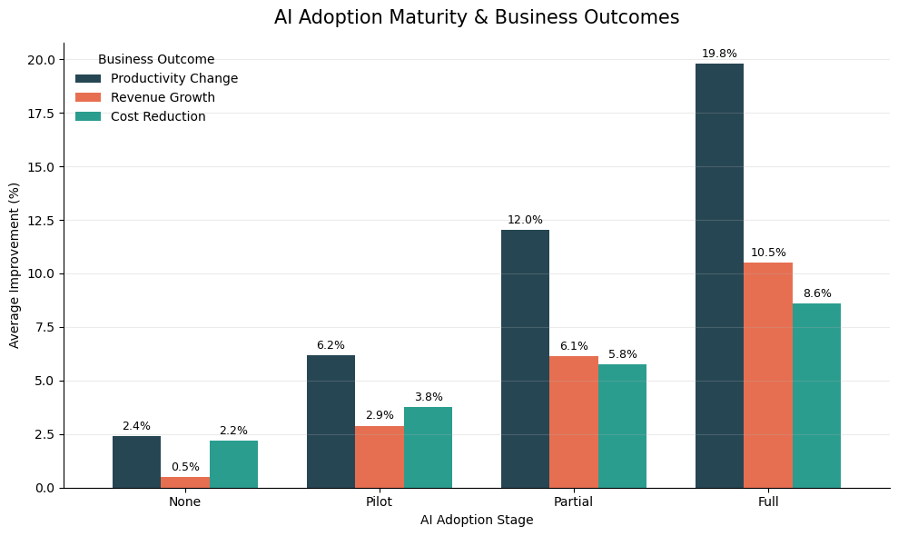
AI Maturity & Business Outcomes
Evaluating whether AI implementation maturity is associated with measurable improvements in organizational performance
AI Maturity Productivity
Strong Positive Correlation
Key Finding: Higher AI maturity was associated with stronger business outcomes, with full adoption associated with the greatest improvements across productivity, revenue, and cost efficiency
Notes:
Key Finding: AI maturity was strongly associated with improved business outcomes.
Interesting points: While evaluating correlation, it was observed that cost reduction did not have any strong correlation. The data shows that companies are moderately seeing revenue growth and cost reduction but Productivity changes are huge. Future studies may show different results as less investment in training and baselining is required.

Slide 6
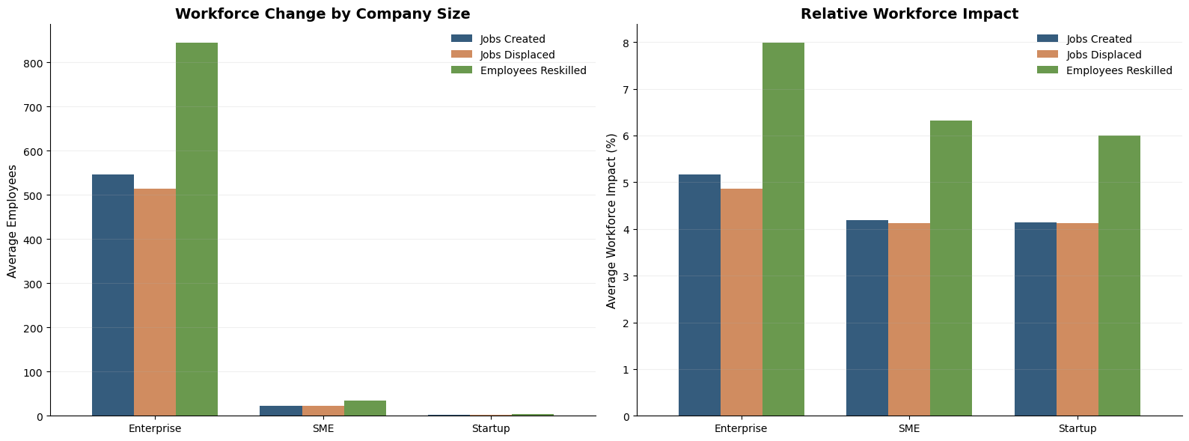
AI Workforce Impact Scale vs Relative Impact
Comparing AI-Driven Workforce Changes Across Company Sizes
Key Finding: Enterprise organizations show the largest workforce shifts by volume, but normalized analysis reveals reskilling is a consistent response across company sizes.
Notes:
Initially, I looked only at total workforce numbers, but that favored enterprise companies because of their size. To compare the impact more fairly, I normalized the results by company size. The trend shows AI creates workforce disruption, but organizations are also investing heavily in reskilling.

Slide 7
Recommendations & Way Forward
Identifying actions to improve AI maturity, workforce readiness, and organizational outcomes
Scale Beyond Pilot Implementation
Prioritize Workforce Transformation
Target Adoption Gaps
Action: Move beyond pilot efforts toward structured AI integration strategies
Why: Mature adoption demonstrated stronger business outcomes
Action: Integrate reskilling into AI adoption plans
Why: Reskilling represented the largest workforce response across company sizes
Action: Identify and address barriers limiting AI maturity
Why: Successful adoption requires aligning technology, processes, and workforce readiness
Notes:
Initially, I looked only at total workforce numbers, but that favored enterprise companies because of their size. To compare the impact more fairly, I normalized the results by company size. The trend shows AI creates workforce disruption, but organizations are also investing heavily in reskilling.

Slide 8
Summary
Questions?
Study Overview
AI Adoption Landscape
AI Maturity & Business Outcomes
Workforce Impacts
Recommendations and Way Forward

